Slide 1
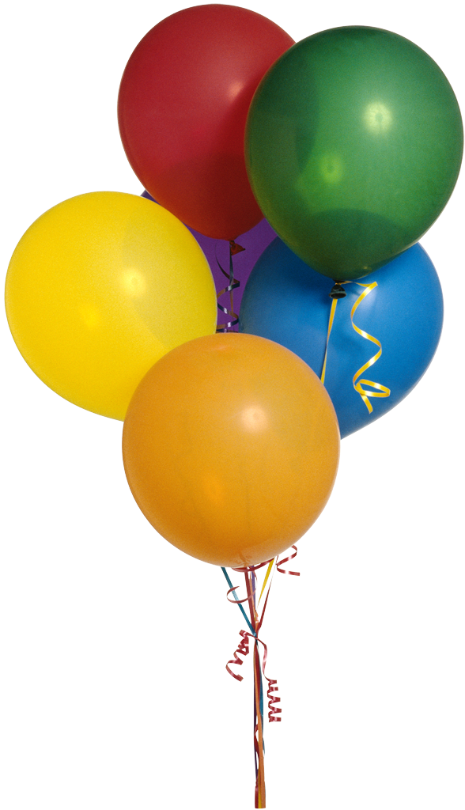
Happy 60th B’day
Tim

Slide 2
Elementary problems encoding computational hardness
P = NP ?
Is any natural problem hard?
Avi Wigderson
IAS, Princeton

Slide 3
Explicit object (graph, number, set,…)_{n}
=
- Explainable
- Reasonable
- Efficiently constructible
- Not random
- Not generic

Slide 4
Linear transformations
Y₁
Y₂
….
Y_{n}
+
+
+
M: F^{n} → F^{n}
y = Mx
+
+
+
+
+
+
+
c
c’
+
+
+
X₁
X₂
….
X_{n}
For most M, size(M) ≈ n²
Challenge: Find explicit M with size(M) ≠ O(n)

Slide 5
Gauss complexity
F any field
M an n×n non-singular matrix over F.
gc(M) = the smallest number of Gauss
elimination steps to make M diagonal
= min {s : M = E₁E₂… E_{s} , E_{i} elementary}
For most M, gc(M) ≈ n²
Challenge: Find explicit M with gc(M) ≠ O(n)

Slide 6
Matrix rigidity [Valiant]
F any field
M an n×n matrix over F.
M “rigid” if a all matrices in Hamming ball
around it has high rank
rig(M) = the smallest number of nonzeros in a matrix S
such that rank(M-S) < n/10
For most M, rig(M) ≈ n²
Challenge: Find explicit M with rig(M) ≠ O(n)

Slide 7
Formula size
f: {0,1}^{n} → {0,1}
∧
∨
∨
∧
X₁
X₅
∧
X_{n}
-X_{j}
X_{j}
-X₅
Fact: For most f, Fsize(f) ≥ exp(n)
Thm Explicit f, Fsize(f) ≥ n³
Challenge: Find f with Fsize(f) ≠ poly(n)
Two directions
[Andreev,
Hastad,Tal]

Slide 8
Composition [Karchmer-Raz-W]
f g
°
f: {0,1}^{n} → {0,1}
g: {0,1}^{k} → {0,1}
f°g: {0,1}^{nk} → {0,1}
Fact: For all f,g Fsize(f°g) ≤ Fsize(f) • Fsize(g) Challenge: Prove Fsize(f°g) ≥ α Fsize(f) • Fsize(g)
for some α>0
f
g
g
g

Slide 9
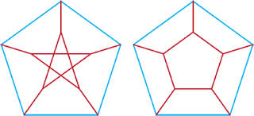
Communication Complexity [Karchmer-W]
G
1
1
H
0
6
2
0
6
2
0
5
5
7
1
7
9
1
9
8
8
4
3
4
3
Alice non-Hamiltonian Hamiltonian Bob
Alice and Bob communicate to solve:
Task: Find (i,j) which is an edge in exactly one of H or G
Task*: Find (i,j) which is an edge in H but not G
Fact: comm(Task) ≤ O(n) bits
Challenge: Prove comm(Task) ≠ O(log n) bits
Thm[KW]: comm(Task) ≤ log Fsize(Hamilton)
Thm[Raz-W]: comm(Task*) ≥ Ω(n) bits

Slide 10
Permanent & Determinant
Det_{n}(X) = ∑_{σ∈Sn} sgn(σ) ∏_{i∈[n]} X_{iσ(i)}
Per_{n}(X) = ∑_{σ∈Sn} ∏_{i∈[n]} X_{iσ(i)}
Easy!
Hard?
f
+
×
×
Arithmetic
circuits
+
+
×
X_{i}
X_{j}
X_{i}
c

Slide 11
Determinantal complexity [Valiant]
Affine map L: M_{n}(F) → M_{k}(F) is good if Per_{n} = Det_{k}° L
dc(n): the smallest k for which there is a good map
Thm[Polya]: dc(2) =2 Per₂ = Det₂
Thm[Valiant]: dc(n) < exp(n)
Thm[Mignon-Ressayre]: dc(n) > n²
Challenge: Prove dc(n) ≠ poly(n)
Thm[V]: Implies exponential lower bounds for Permanent
a b
c d
a b
-c d

Slide 12
Polynomial identities [Heintz-Schnorr,Agrawal,Kabanets-Impagliazzo]
Symbolic matrix M (0,1,X₁…,X_{n})
Is det(M) = 0 identically ?
Small Hitting Set (of small integer
substitutions). Set k=n¹⁰ (say).
H = {v₁, v₂, … v_{k}}, a set of vectors in [k]^{n}
det(M) ≠ 0 ➔ det(M(v_{i})) ≠ 0 for some i
Most H are small hitting sets
Challenge: Find an explicit H
Thm[A,KI]: Implies exponential lower bounds for Permanent
0
X₁
0
X₅
X₁
X₂
n
X_{n}
1
X₁
1
X_{n}
n

Slide 13
Elusive curves [Raz]
Everything over C (works for other fields)
Fact: The moment curve avoids every hyperplane!
f(x) = (x,x²,x³,…, x^{n}) of degree n, avoids deg 1 maps:
for every G: C^{n-1} → C^{n} of degree 1, Im(f) $⊈$ Im(G)
Challenge: Find an explicit curve of degree poly(n)
which avoids all degree 2 maps.
Thm[Raz]: Implies exponential lower bounds for Permanent

Slide 14
Sum-of-Squares [Hrubes-W- Yehudayoff]
(X₁²+X₂²+ … +X_{k}²)(Y₁²+Y₂²+ … +Y_{k}²) = B₁²+B₂²+ … +B_{n}²
B_{i}=B_{i}(X,Y) Bilinear functions. n = n(k) ≤ k² Do better?
n=1 (X₁²)(Y₁²) = (X₁Y₁)²
n=2 (X₁²+X₂²)(Y₁²+Y₂²) = (X₁Y₂+X₂Y₁)² + (X₁Y₁-X₂Y₂)²
n=4 (X₁²+…+X₄²)(Y₁²+…+Y₄²) = B₁²+B₂²+ … +B₄² Euler
n=8 (X₁²+…+X₈²)(Y₁²+…+Y₈²) = B₁²+B₂²+ … +B₈² Hamilton
Thm[Hurwitz1898] 1,2,4,8 are the only ones with n=k
Thm[Radon1922] n_{Z}(k) < k²/logk
Thm[HWY2013] n_{Z}(k) > k^{6/5}
Thm[James1967] n_{R}(k) > 2k
Thm[Hrubes2024] n_{C}(k) < k^{1.62}
Challenge: Prove n_{C}(k) > k^{1+ε}
Thm[HWY] ➔ exponential non-commutative circuit lower bound.

Slide 15
Why do Lower bounds manifest
themselves in so many ways?
Computation is everywhere!

Slide 16
Which groups are expanding?
G group, S$⊆\text{G}\text{, }$
Cay(G;S): Cayley graph, V=G, E={(g,gs) : g∈G, s∈S}
Expanding: $λ$(Cay(G,S)) <.9 fundamental concept
{G_{n}} expanding, if $∃$|S_{n}|<O(1), s.t. $λ$(Cay(G_{n},S_{n})) <.9
Simple groups are expanding families!
- [Margulis]…[Lubotzky-Philips-Sarnak]…
- [Kassabov-Lubotzky-Nikolov]
- [Helfgott] [Bourgain-Gamburd]…[Breuillard-Guralnik-Green-Tao]
------------------------------
[Sarnak-Xue][Balog-Szemeredi;Gowers]

Slide 17
Which groups are expanding?
Abelian groups are not expanding!
[Folklore] G abelian, expanding ➔ |S|> log |G|
[Alon-Roichman] Tight! Random S works.
[Lubotzky-Weiss] G solvable of derived length n, expanding ➔ |S|> log^{(n)} |G|
[Meshulam-W] Tight! $∃$G_{n} as above, |S_{n}|< log^{(n’)} |G|
Very non-simple expanding family G_{n} = (G_{n-1}) $∫$A_{d}
Fix d>1000, T_{n}: d-ary tree of height n
[Rozenman-Shalev-W] G_{n}: even symmetries of T_{n}
Expanding with |S_{n}|=O(1)
Zigzag product [Reingold-Vadhan-W][Alon-Lubotzky-W]

Slide 18
Book ad
- Published by Princeton University Press
- Free on my website
- Comments welcome!

